Slide 1
PROTEIN FAMILY SEQUENCING USING MACHINE LEARNING
Done By:
Team Avengers
D. Sai Tharun Reddy
Sandeep Preetham
T.Rohit

Slide 2
CONTENTS
INTRODUCTION
PROTEINS
PROTEIN SEQUENCE
PROTEIN FAMILY
NAIVE BAYES CLASSIFIER

Slide 3
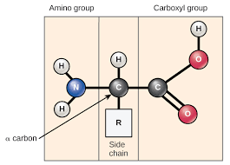
AMINO ACID

Slide 4
WHAT ARE PROTEINS ?
Proteins are large, complex molecules that play many critical roles in the body.
The linear structure of amino acids within a protein is considered the primary structure of the protein.
All the amino acids within the protein are linked together by peptide bonds helping in forming a long chain.
Proteins are built on a set of twenty amino acids, each amino acid being unique from the other.

Slide 5
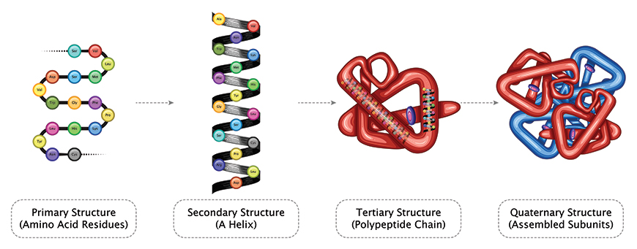
CLASSIFICATION OF PROTEIN STRUCTURE
PRIMARY
SECONDARY
TERTIARY
QUATEMARY

Slide 6
PROTEIN SEQUENCING
Protein sequencing is the practical process of determining the amino
acid sequence of all or part of a protein .
It is a method to understand the structure and function of proteins in living organisms.
The linear order of amino acids in each protein determines its three-dimensional structure and activity .

Slide 7
APPLICATIONS OF PROTEIN SEQUENCING
Drug production
In bioinformatics
Used for the prediction of final structure , function and location of protein .
Antibiotic production .

Slide 8
PROTEIN FAMILY
Protein with similar shape and sequence tend to perform similar function within the call and hence they are classified as a protein family
Protein In a family descend from a common ancestor (homology ) and typically have similar three-dimensional structures , function and significant sequence similarity
It is estimated that over 60,000 protein families have been defined.

Slide 9
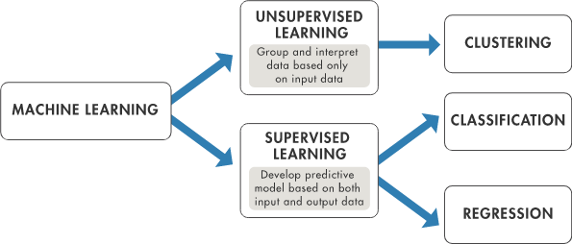
Machine Learning

Slide 10
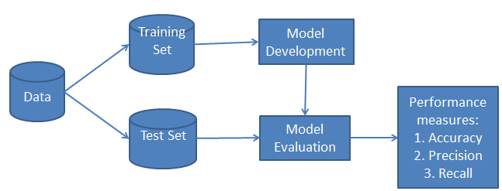
Classification Workflow:

Slide 11
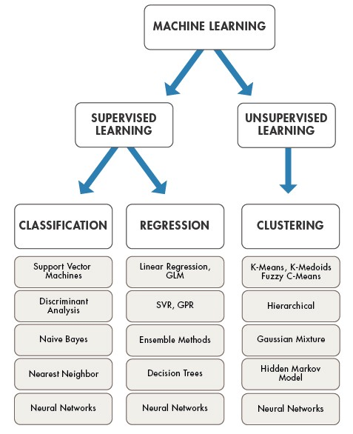
Supervised Learning

Slide 12
NAIVE BAYES CLASSIFIER
A Naive Bayes classifier is a probabilistic machine learning model that’s used for classification task.It is a statistical classification technique based on Bayes Theorem.
Naive Bayes classifier is the fast, accurate and reliable algorithm.
Formula for calculating the conditional probability:

Slide 13
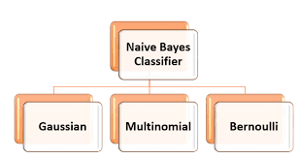
TYPES OF NAIVE BAYES MODEL UNDER THE SCIKIT-LEARN LIBRARY
Gaussian: It is used in classification and it assumes that features follow a normal distribution.
Multinomial: It is used for discrete counts.
Bernoulli: The binomial model is useful if your feature vectors are binary

Slide 14
MULTINOMIAL NAIVE BAYES CLASSIFIER:
Multinomial Naive Bayes consider a feature vector where a given term represents the number of times it appears or very often i.e. frequency.
If the words are represented in terms of their occurrences (frequency count) then use multinomial event model.

Slide 15
ADVANTAGES/DISADVANTAGES OF NAiVE BAYES
ADVANTAGES :
Naive Bayes Algorithm is a fast, highly scalable algorithm.
It can be easily trained on small datasets.
Handle real and discrete data
Disadvantages:
Assumes independence of feature .

Slide 16


